Slide 1
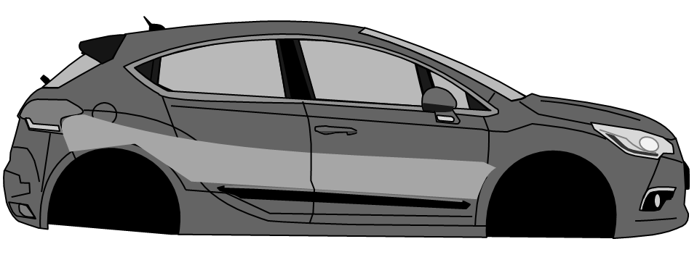
Switching Gears
HYBRID & ELECTRIC VEHICLES
Ashley Rios
Professor Matlack
Notes:
The purpose of this presentation is to explain the reasoning behind diversification into the hybrid and electric vehicle manufacturing industry. This subset of the auto manufacturing industry is growing substantially and will continue to do so.

Slide 2



Current Condition of the auto manufacturing Industry
COVID-19 caused a large drop in industry value that has not fully recovered
Hybrid & electric vehicles were 15% of sales in 2022 (10% in 2021)
Industry valued at $326 billion (May 2023)
Notes:
The effects of 2020 and the COVID-19 pandemic are still greatly impacting the automotive engine manufacturing industry. A hopeful prospect of the auto industry is the growing segment of hybrid and electric vehicles. Recent reports from May 2023 value the industry at around $326 billion (Pantalon, 2023). This is an increase from last year, but not significant enough to surpass 2018 values.

Slide 3
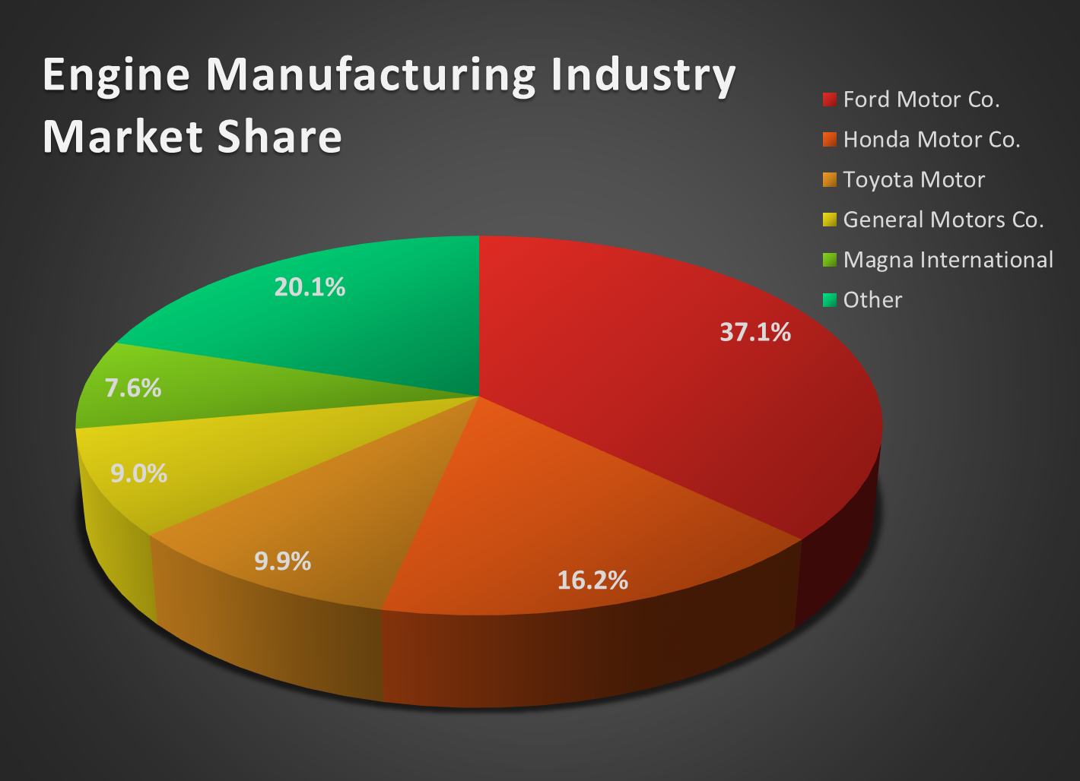
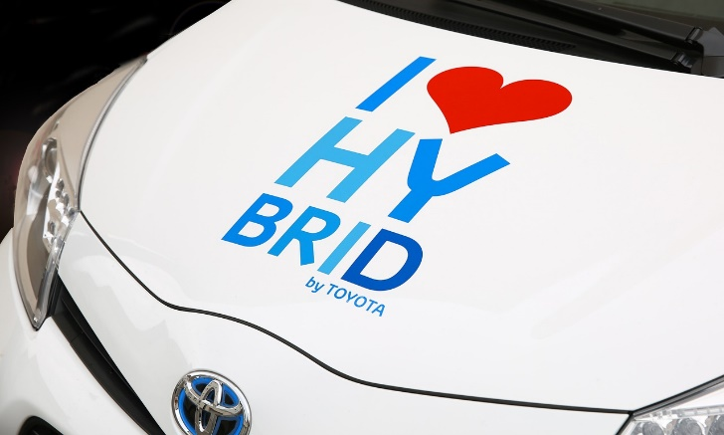
Competition in Auto Manufacturing
Ford Motor Co. holds largest US market share
4 out 5 top engine manufacturers are also automakers
“Toyota is currently investing heavily in its hybrid & electric vehicle offering aiming for half of its global sales to be accounted for by hybrid & electric vehicles by 2025” (MarketLine, 2021).
Notes:
The top competitor in the auto engine manufacturing industry is Ford Motor Co., who holds about 37% of the current market. Of the top five competitors, Magna International is the only organization that is not also an automaker. The remaining 20% of the market share is held by smaller companies (Pantalon, 2023). Each of these auto manufacturers have emphasized their plans to increase the hybrid and electric division of their fleets.

Slide 4
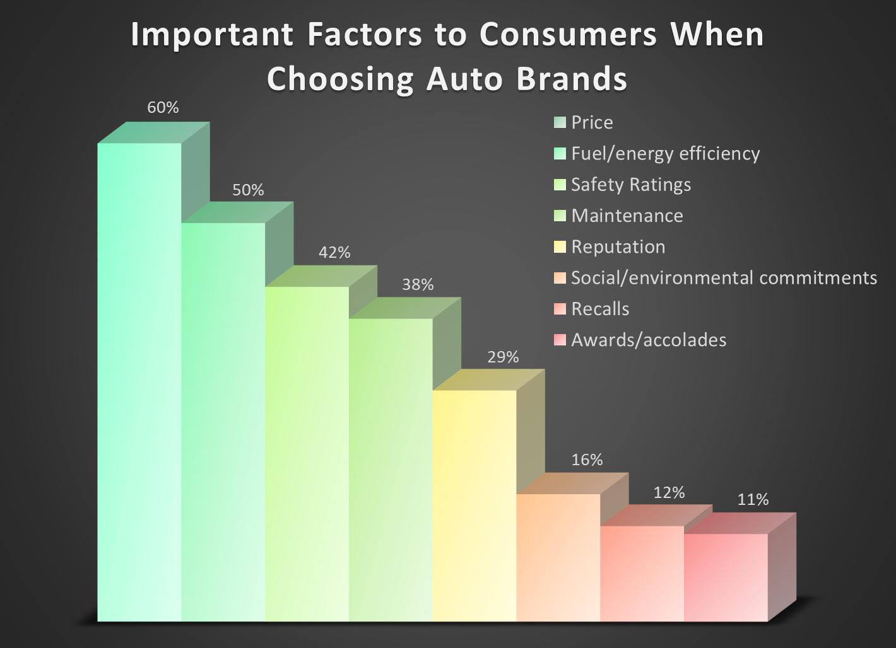

Consumer Preferences
Consumers care most about Price and Fuel/energy efficiency
Recalls and awards/accolades least important factors
Notes:
According to recent studies, consumers deem price the most important factor when choosing an auto brand. The next highest factor they considered was fuel/energy efficiency (Sanchez, 2023). This information illustrates that consumers are taking energy efficiency into account when making a vehicle purchase, highlighting the significance of the hybrid and electric vehicle industry.

Slide 5
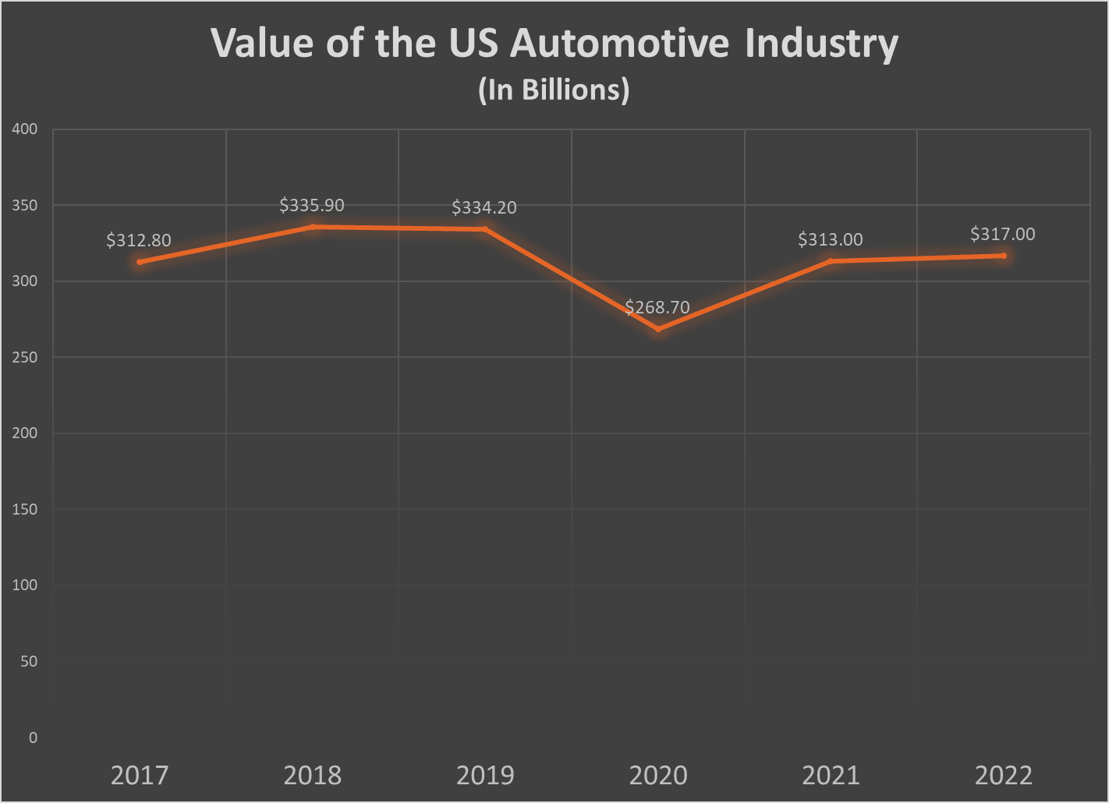
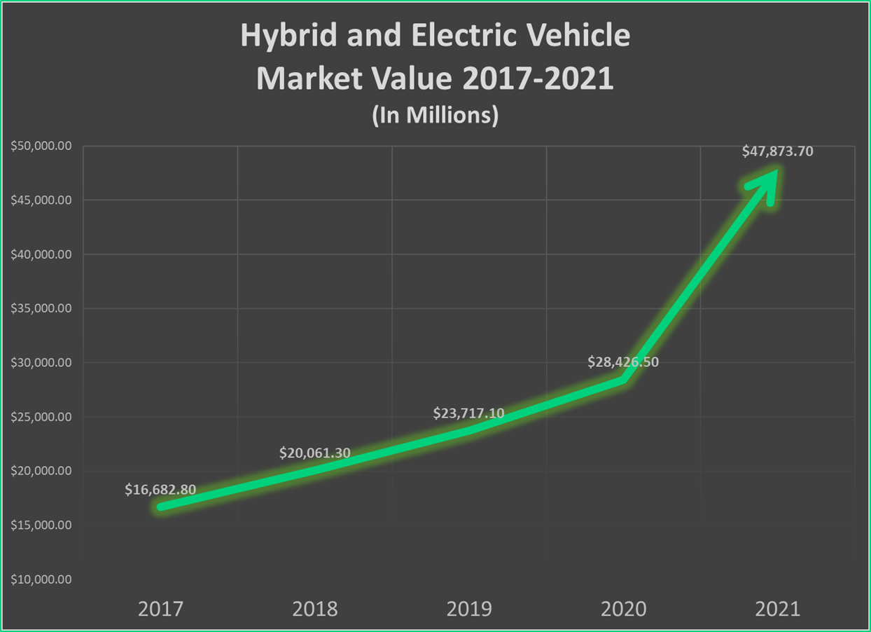
Why Diversify?
Market value almost tripled since 2017
Many current competitors have already diversified into this industry
Current industry is saturated
No growth since 2018
Notes:
Diversifying into the manufacturing of hybrid and electric vehicles makes sense for our organization. This is a closely related industry, and the current engine auto manufacturing industry is saturated and declining. The demand for clean energy and green vehicles is continuing to grow. Diversifying into this industry will help our organization to increase revenue as the demand for gas vehicles decreases. Most other major automakers have already began developing and producing hybrid or electric vehicles with most vowing to phase out gas vehicles completely within the next ten years.

Slide 6


Why Hybrid & Electric Vehicle Manufacturing?
Hybrid and electric account for 10% all vehicles sold (2.7% in 2017)
Expected to reach $75 million value by 2026
Federal tax breaks make this industry more appealing
“You may qualify for a credit up to $7,500…if you buy a new, qualified plug-in EV or fuel cell electric vehicle” (IRS.gov)
Notes:
This industry has had major growth over the last decade. As of 2021, hybrid and electric vehicle sales account for 10% of all vehicles sold, a sizeable increase from 2017 when they were only 2.7% of sales (MarketLine, 2022). Analysts forecast that this industry will be valued at around $75 million by 2026 (MarketLine, 2022). The federal government has also implemented tax breaks for consumers who purchase hybrid or electric vehicles, making this market more appealing to diversify into as public interest grows.

Slide 7
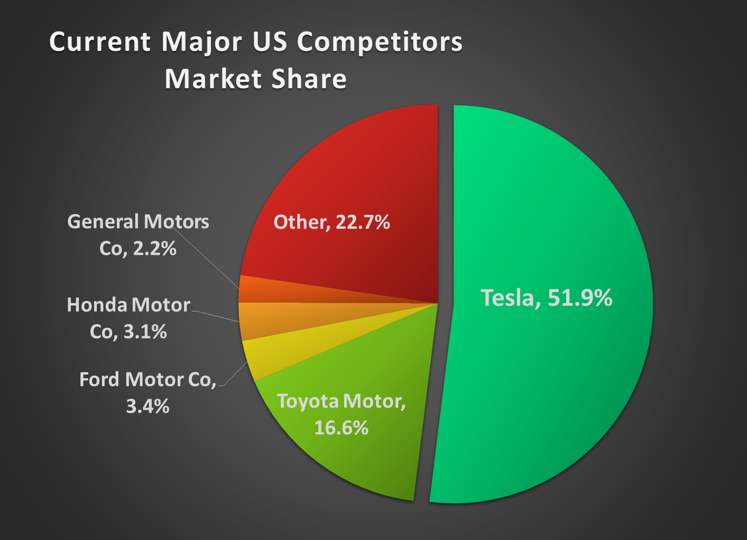
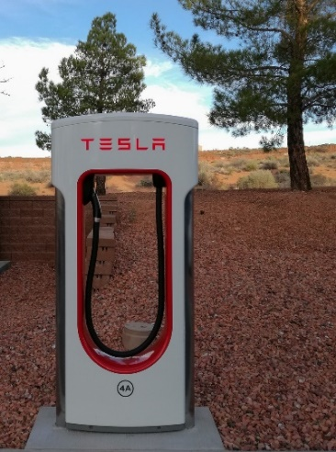
Hybrid & Electric Market Competition
Tesla holds more than half market share
Most automaker giants are putting more research and development into hybrid and electric
The market is not saturated:
Number of hybrid and electric manufacturers has grown 13% in 2023
Notes:
The current industry leader is Tesla, who is also the only organization specialized in the electric vehicle industry. Tesla holding more than half the market share has only increased rivalry among the other major automakers. With the introduction of longer-lasting batteries and other technological improvements to hybrid and electric vehicles, there is still room for moderate competition and new entrants in this industry.

Slide 8

Positive Impacts of Diversification
Increased growth and revenue
Boost employee morale
Improved social reputation (“Going Green”)
Government tax breaks and incentives
Reduces market dependence
Makes financial sense
Notes:
Diversifying into the hybrid and electric manufacturing industry can have a variety of potential impacts. Diversification and expansion could lead to increased opportunities for growth. The business agreements the organization currently has with automakers can be extended, as they are also putting more focus into hybrid and electric vehicles and so are we. These growth opportunities can lead to increased sales and revenue, as we are providing a larger variety of engines to a new type of vehicles. This will also help reduce our dependence on the current industry. Diversifying can also raise employee morale, as they will feel good about the company entering a ‘green’ industry. This will also improve the organization’s social reputation. Tax breaks and incentives will help the company save money that can be invested into research and development to ensure our organization is at the forefront of technology. Overall this makes financial sense for our organization.

Slide 9

POTENTIAL NEGATIVE IMPACTS
High costs/barriers to entry
High threat of substitutes
No guarantee of success
Notes:
With every business plan, there is the possibility of issues or downsides. Some disadvantages of diversifying into a new industry include the high costs and other barriers to entry. The positive aspect of our organization is that we already have raw material suppliers that supply many of the same materials needed for the new industry. There is also a high threat of substitutes that will always remain with this industry, including public transportation and used or gas vehicles. The industry is currently considered a luxury, an ideal that will lessen as vehicles become more affordable. While there is no guarantee of success, the odds are considerably good for our diversification plan.

Slide 10
Likelihood of success
Based on research and the data provided, there is a strong likelihood of success. The hybrid and electric manufacturing industry is still reasonably new and has lots of room for new competitors. The markets are closely related, so moving into this industry should be relatively straightforward.

Slide 11
NEXT STEPS
CLOSING POINTS
The traditional automotive manufacturing industry is declining. The industry has not seen growth in five years, especially after the 2020 pandemic.
Hybrid and electric vehicles will continue to take more market share of the automotive industry, we should not be the only organization left behind
Putting resources into R&D to begin developing a product strategy
Contact suppliers to alter contracts based on raw materials needed for new products
Notes:
The hybrid and electric vehicle industry is a growing piece of the auto manufacturing industry overall. Hybrid and electric vehicle sales have increased from 2.7% in 2017 to 10% only four years later. With the introduction of governmental legislation including tax breaks for consumers, the hybrid and electric vehicle industry is expected to continue expanding within the auto manufacturing industry. The auto engine manufacturing industry has seen slowed growth, and the promotion of eco-friendly vehicles has shown how the organization needs to adjust and grow with the changing times and changing desires of consumers. The hybrid and electric vehicle manufacturing industry has seen substantial growth and will continue to do so as more automakers transform their fleets and stop producing gasoline vehicles. The data presented suggests that diversification into the hybrid and electric vehicle industry would solve the company's problem of being left behind making only gas-powered engines. The hybrid and electric industry has plenty of room for added competition, as the industry is still in its initial stages and will continue to expand as more technological developments are made.

Slide 12
REASONING & RATIONALE
This decision was made using the
RATIONAL DECISION MODEL
Researching multiple solutions and analyzing them to find the best course of action
Why this decision-making model?
This decision should not be taken lightly
Deciding to diversify requires major change and large amounts of capital
Notes:
The Rational Decision Model was used in this decision-making process. The Intuitive Decision and Recognition-Primed Decision Model were both considered, but ultimately both of these models are meant for making fast decisions when there is not enough time to research multiple options. The Rational Decision Model is relevant in developing this diversification plan because this decision does not need to be made as quickly and will require major structural changes to the organization as a whole. Each person in the organization will be affected by diversification into a new industry.

Slide 13
REFERENCES
Al Bari, S. (2023, April 11). Hybrid & Electric Vehicle Manufacturing in the US. IBISWorld. https://my-ibisworld-com.ezproxy.snhu.edu/us/en/industry-specialized/od4516/about
Charging Station Illustration image. By Succo via Pixabay. https://pixabay.com/vectors/charging-station-electric-gas-station-2276054/
Charging Station Logo image. By stormautomobile via Pixabay. https://pixabay.com/vectors/charging-station-logo-5261309/
Electric Car Exit Sign image. By geralt via Pixabay. https://pixabay.com/illustrations/electric-car-gas-station-environment-2728143/
Factory Worker image. By jannonivergall via Pixabay. https://pixabay.com/photos/worker-grinder-factory-workplace-5736096/
Illustrated Automobile image. By OpenClipart-Vectors via Pixabay. https://pixabay.com/vectors/automobile-car-red-french-old-1300467/
Internal Revenue Service. (2023, April 17). Credits for New Clean Vehicles Purchased in 2023 or After. https://www.irs.gov/credits-deductions/credits-for-new-clean-vehicles-purchased-in-2023-or-after
Internal Revenue Service Logo image. (2023, February 18). https://1000logos.net/irs-logo/
Jabbar, W. (2023, February 8). Diversification Strategy Advantages And Disadvantages. Business Data List. https://businessdatalist.com/diversification-strategy-advantages-and-disadvantages/
Man Working on Vehicle image. By jatinderjeetu via Pixabay. https://pixabay.com/photos/man-repair-vehicle-car-business-7669846/

Slide 14
REFERENCES (continued)
MarketLine. (2021, November 30). MarketLine Industry Profile: Automotive Manufacturing in the United States. https://advantage-marketline-com.ezproxy.snhu.edu/Analysis/ViewasPDF/united-states-automotive-manufacturing-145511
MarketLine. (2022, April). MarketLine Industry Profile: Hybrid & Electric Cars in the United States. https://advantage-marketline-com.ezproxy.snhu.edu/Analysis/ViewasPDF/united-states-hybrid-electric-cars-152737
Pantalon, M. (2023, May). Automobile & Light Duty Motor Vehicle Manufacturing in the US. IBISWorld. https://my-ibisworld-com.ezproxy.snhu.edu/us/en/industry/33611/about
Person Sitting on Car image. By Pexels via Pixabay. https://pixabay.com/photos/car-grass-nature-outdoors-person-1845574/
Person with Steering Wheel image. By 5033181 via Pixabay. https://pixabay.com/photos/steering-wheel-seat-wheel-transport-2209953/
Sanchez, G. (2023). Marketing Auto to Gen Z & Millennials. Mintel. https://reports-mintel-com.ezproxy.snhu.edu/display/1157811/
Stay Home Save Lives Logo image. By gregroose via Pixabay. https://pixabay.com/vectors/stay-home-save-lives-logo-field-4983843/
Tesla Charging Station image. By McRonny via Pixabay. https://pixabay.com/photos/tesla-electric-car-e-mobility-e-car-2718189/
Toyota Hybrid image. By Hermann via Pixabay. https://pixabay.com/photos/hybrid-hybrid-vehicle-hybrid-car-428183/

